Slide 1

Welcome
to
Online Food Delivery

Slide 2
PROJECT MEMBERS
Deepika R - 2563626
Ranganayaki Palanisamy -2563364
Lakkasani Ramesh Reddy -2563892
B Bharath Reddy -2563149
Hemant Singh Rajpurohit -2563052
Mallem Sivateja Kumar - 2564343

Slide 3
ABSTRACT
ONLINE FOOD ORDER SYSTEM is a website designed primarily for use in the food delivery industry.
This system will allow hotels and restaurants to increase the scope of business by reducing the labor cost involved.

Slide 4
INTRODUCTION
Meal Monkey is an online food delivery web application for ordering food items of different cuisines from a restaurant.
Meal Monkey is a restaurant chain that delivers food items of different cuisines at affordable prices.

Slide 5
TECHNOLOGY USED
Front End:
HTML,CSS3 and Bootstrap4.
TypeScript: Angular/NodeJS.
Git.
GitHub.
Back End:
Spring Boot , Hibernate , MySQL.

Slide 6
ENVIRONMENT
The system will be developed on any Windows OS machine using J2EE, Hibernate, and Spring.
Intel hardware machine
Server – Apache Tomcat 8
Database – My SQL
Node Version
Angular CLI
JDK
Eclipse IDE or Spring Tool Suite

Slide 7
MODULES OF ONLINE FOOD DELIVERY SYSTEM
Registration Page.
Login Page.
User Login/Logout
Admin Login.
Dashboard.
Search Products.
Add Cart/View Cart.
Add product/Update Product/Delete Product
View Previous Active Orders.
Payment Gateway Page.
Order Summary Confirmation Page.

Slide 8
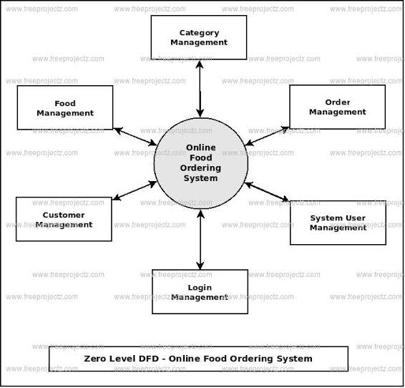
PROJECT FLOW

Slide 9
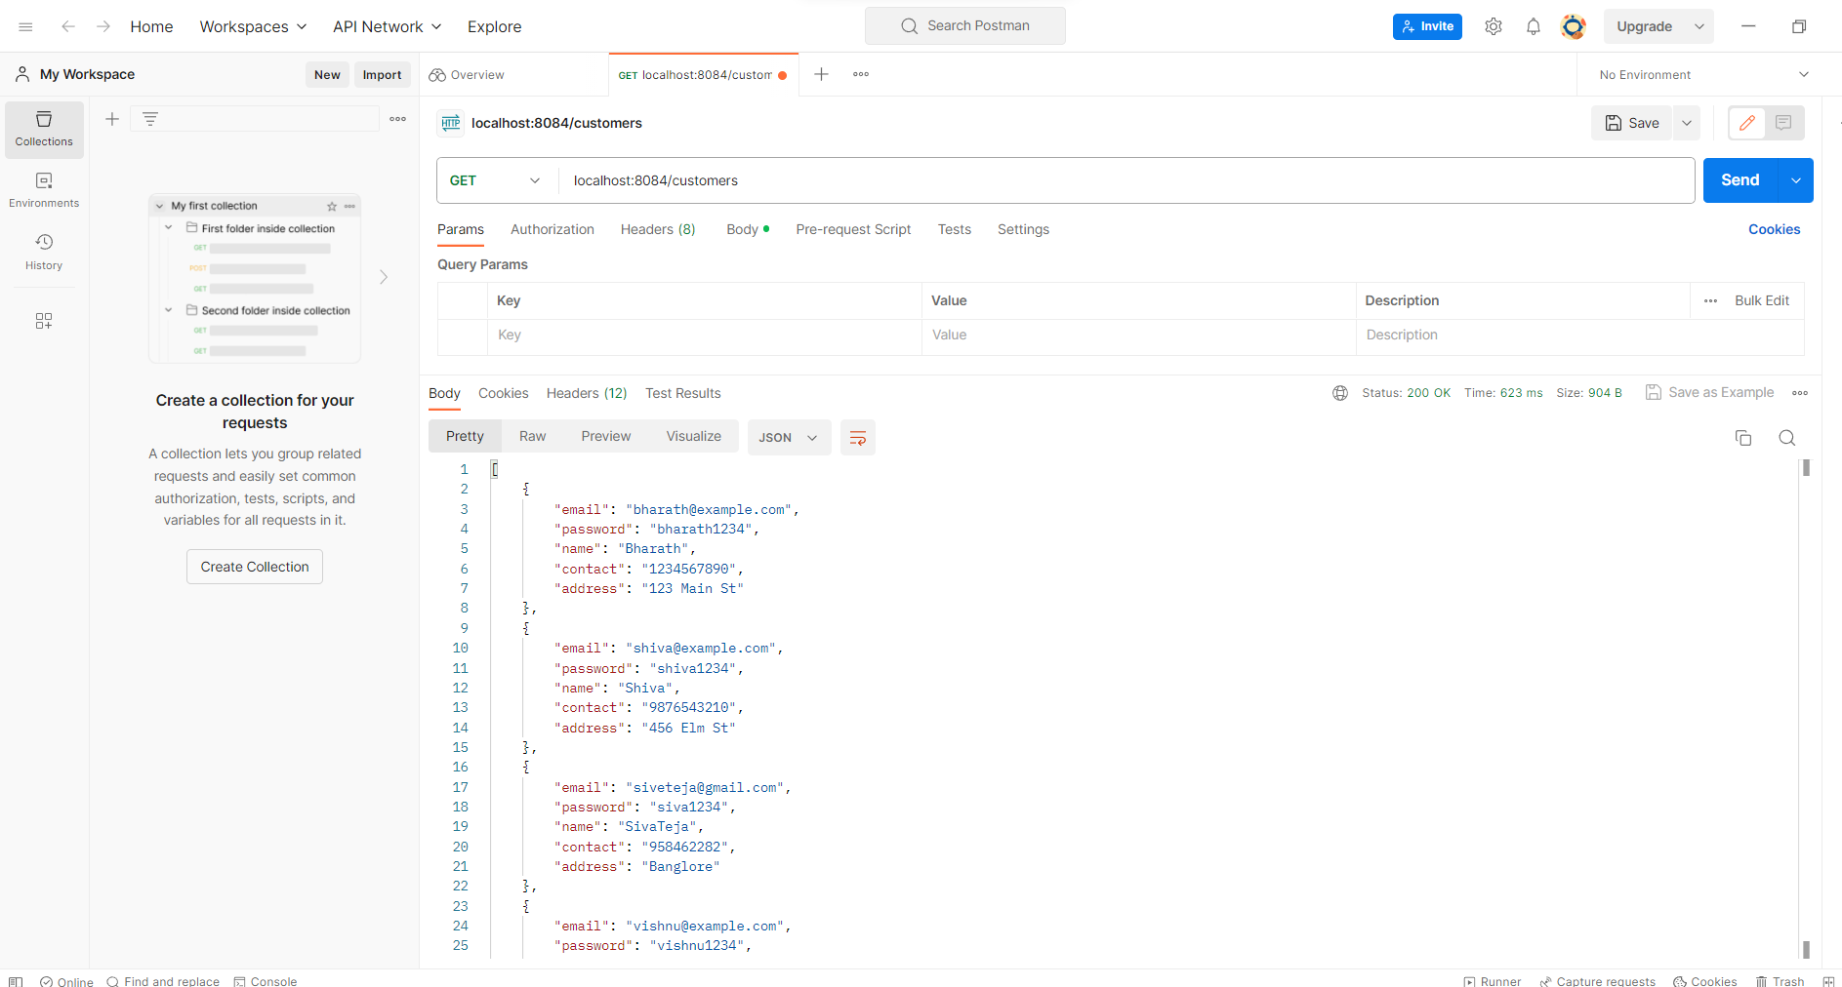
OUTPUT SCREENSHOTS
Functional Postman Testing

Slide 10
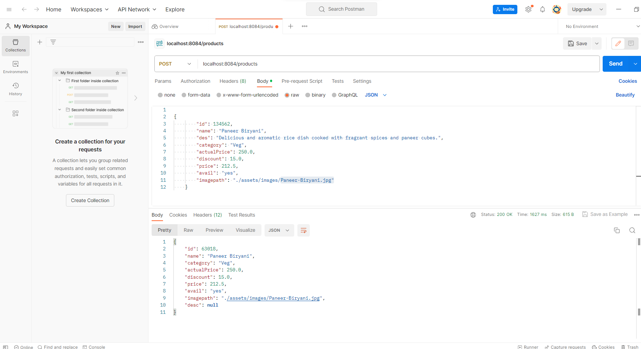
OUTPUT SCREENSHOTS
Functional Postman Testing

Slide 11
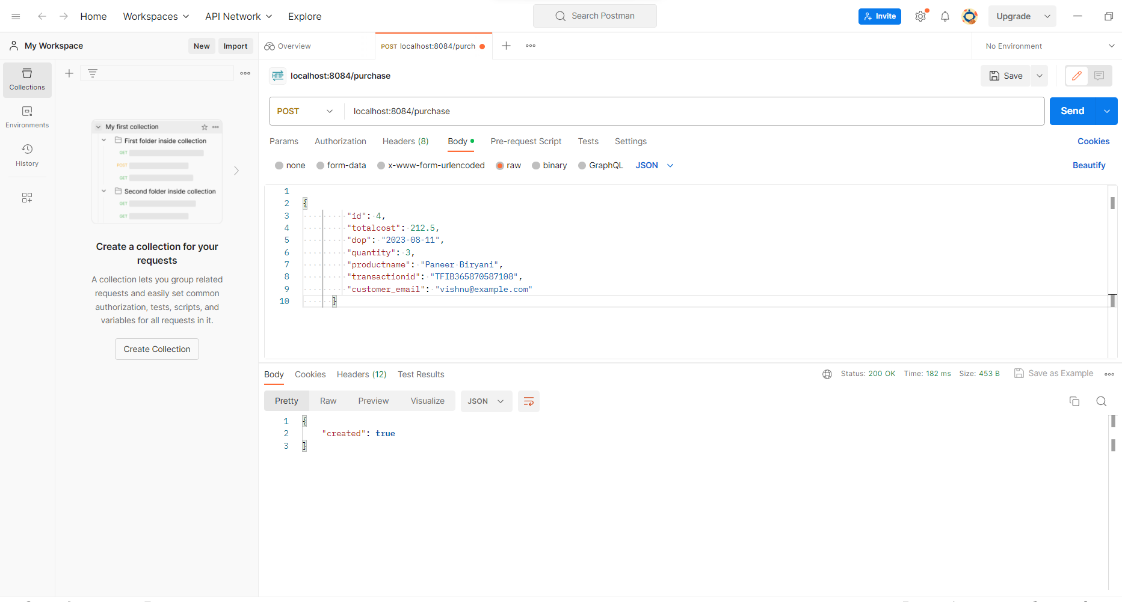
OUTPUT SCREENSHOTS
Functional Postman Testing

Slide 12
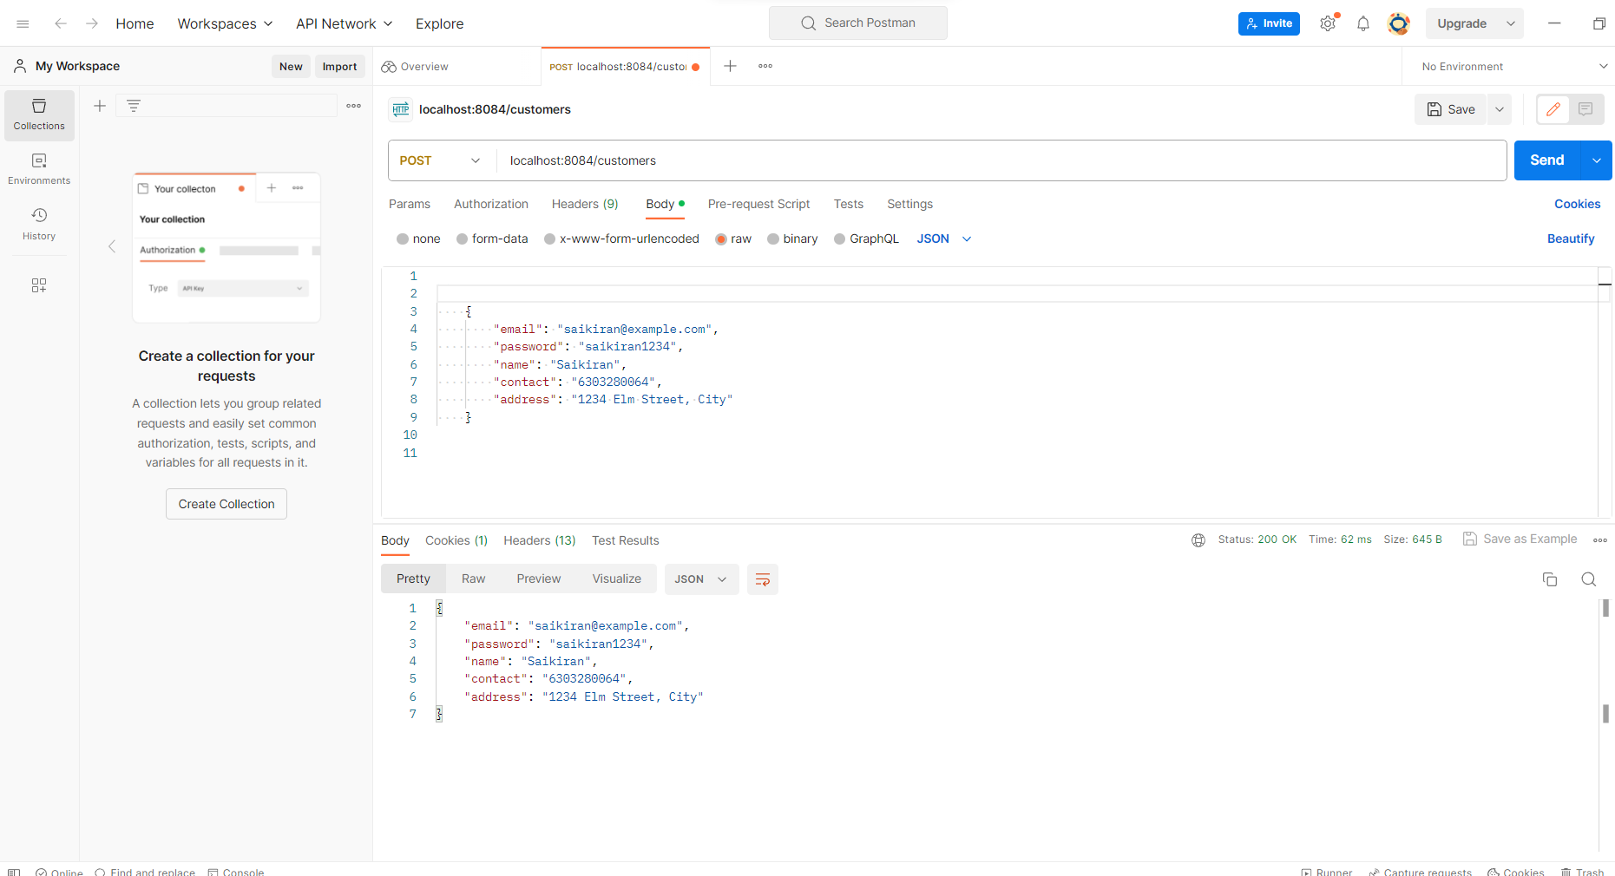
OUTPUT SCREENSHOTS
Functional Postman Testing

Slide 13
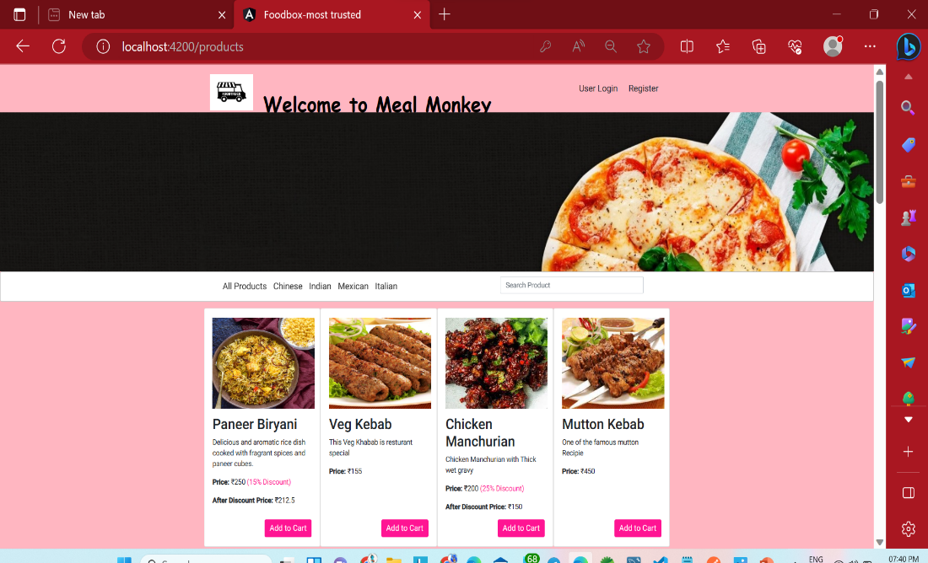
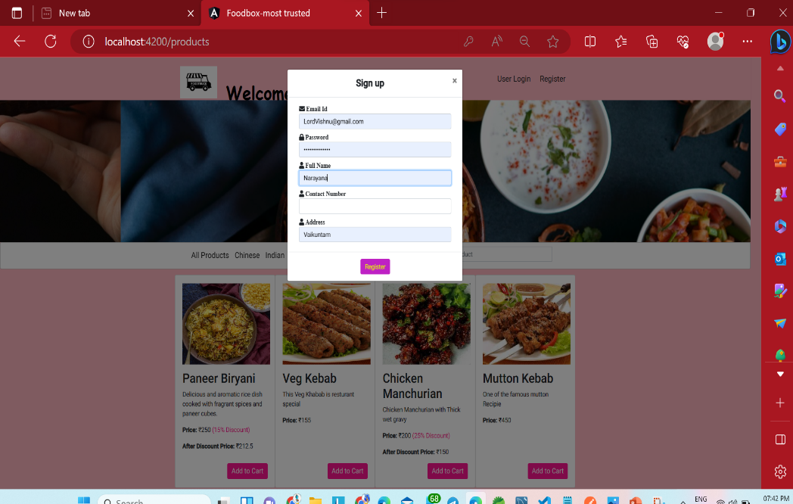
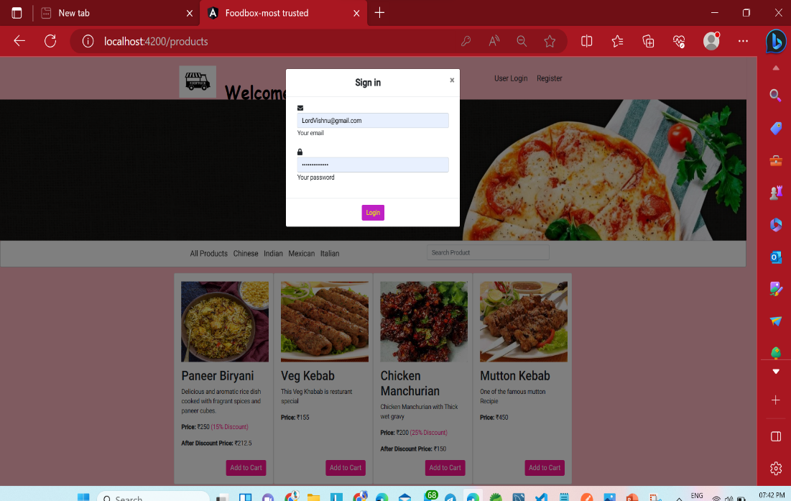
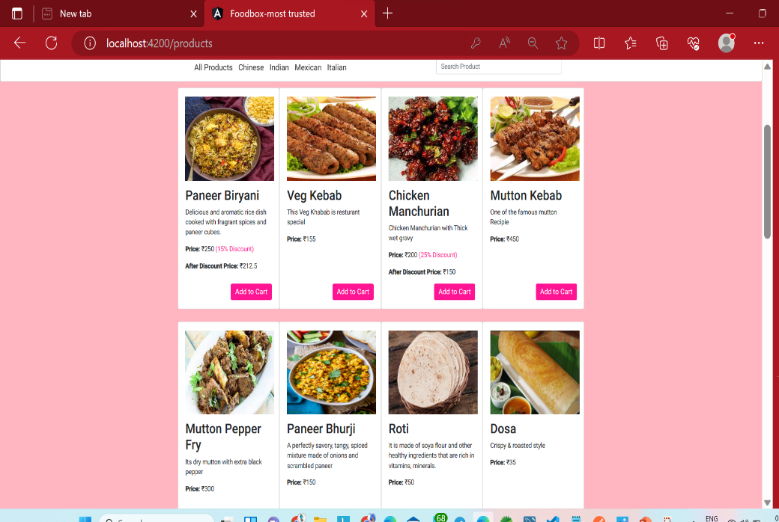
Restaurant Page
Register Page
User Page
All Products

Slide 14
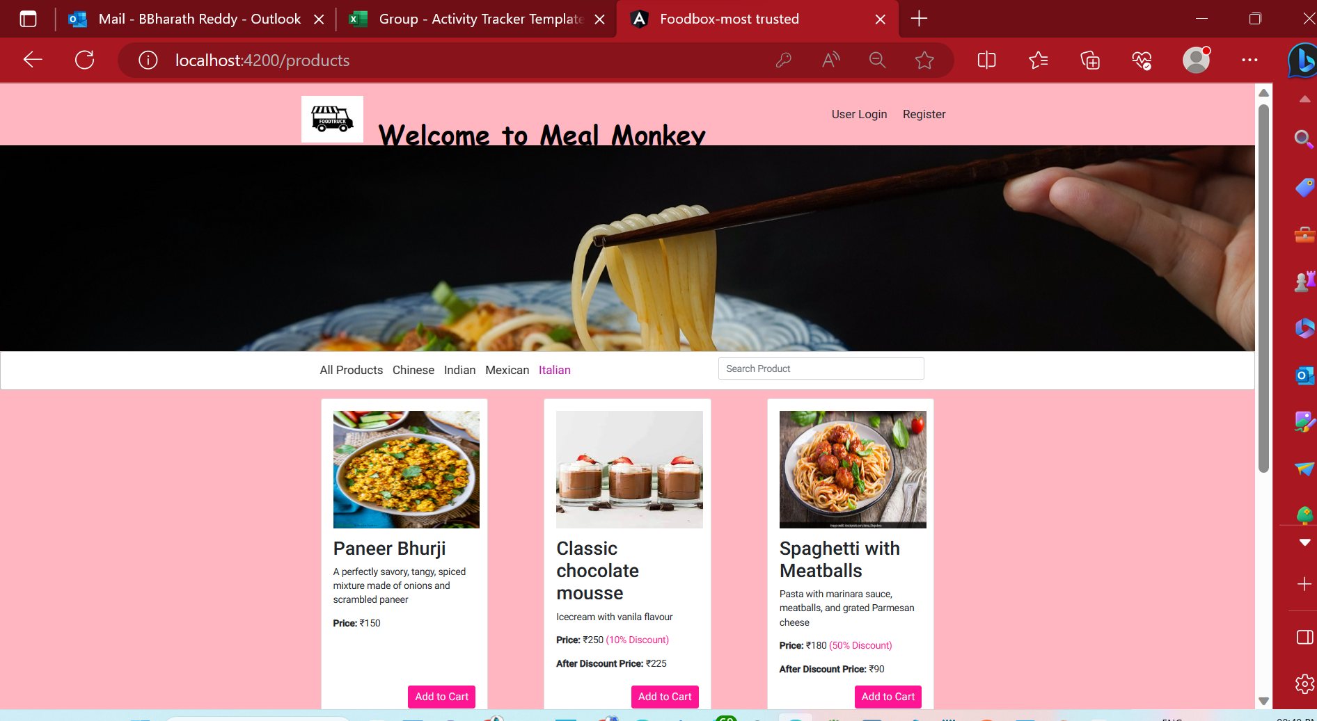
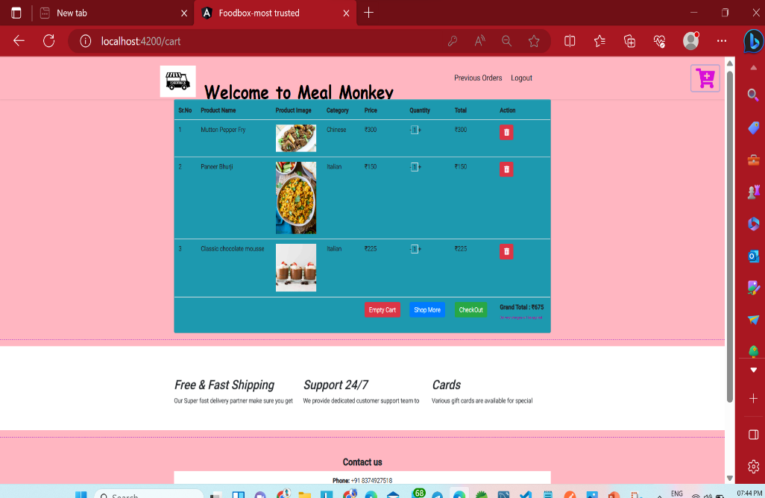
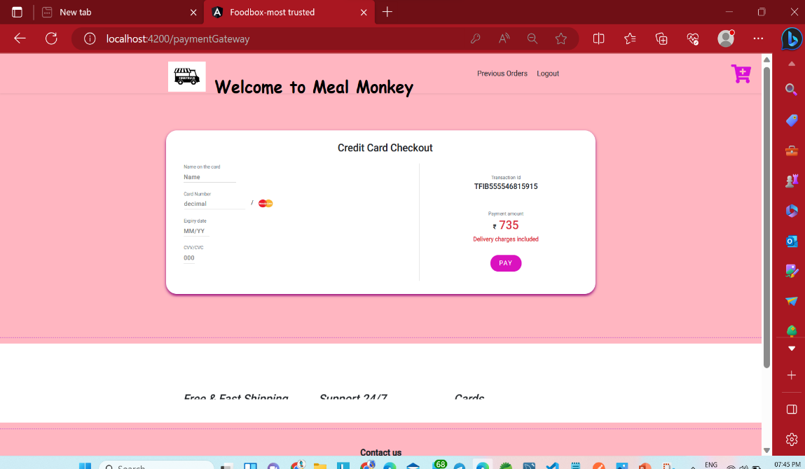
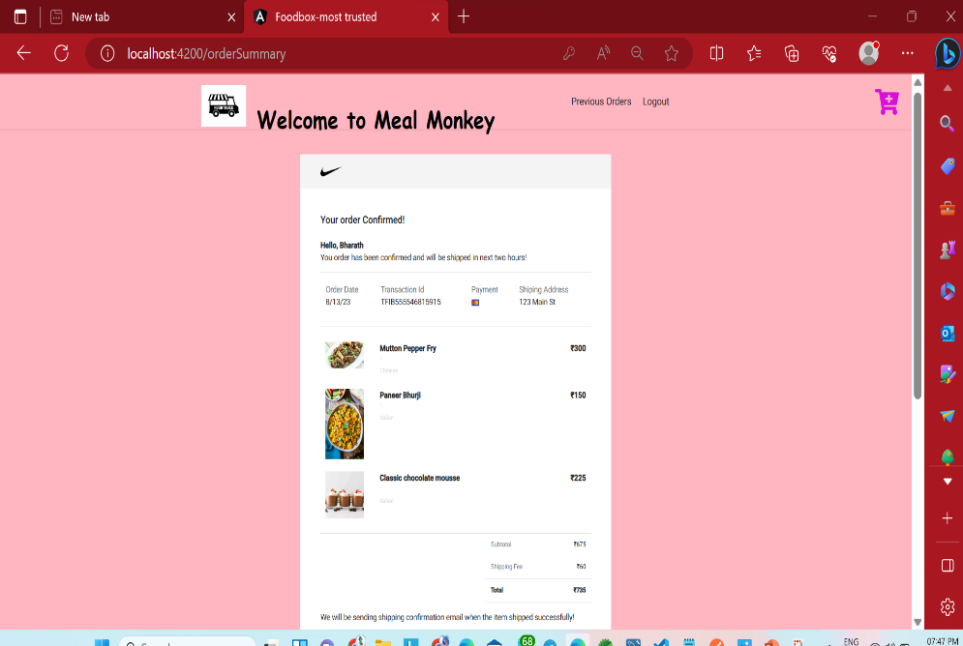
Italian Products
After adding products to cart
Card details
After payment order cofirmed

Slide 15
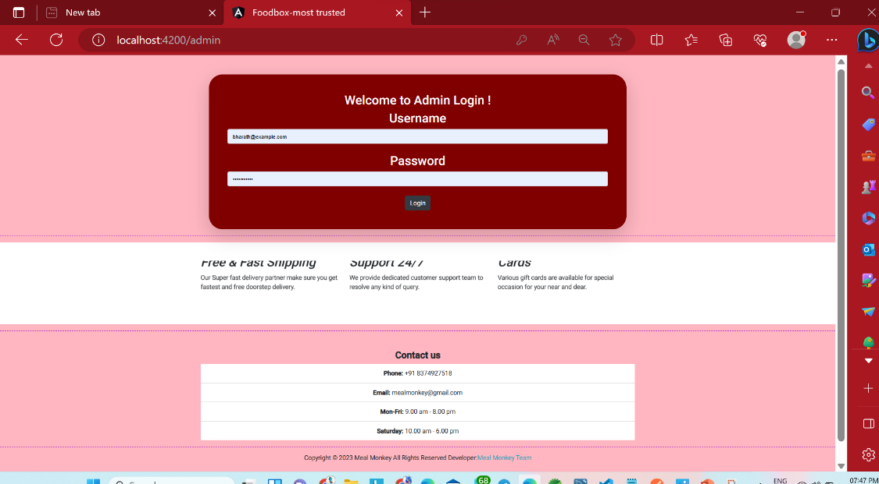
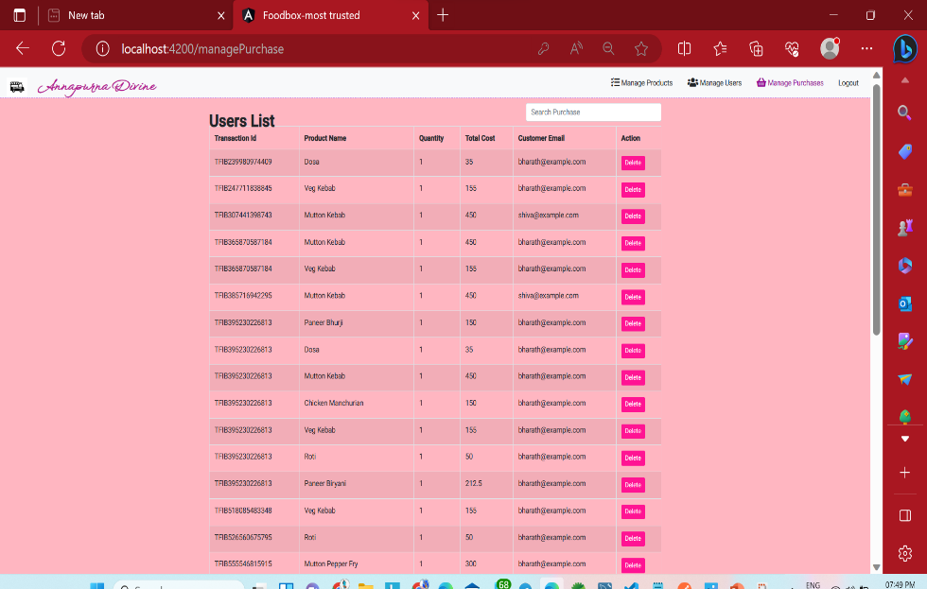

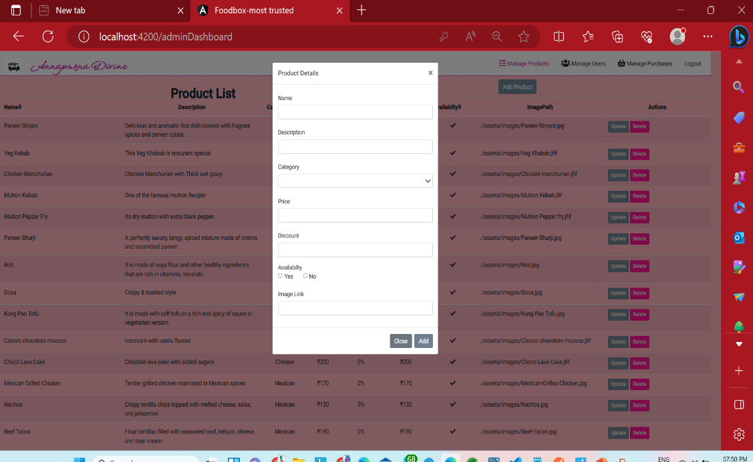
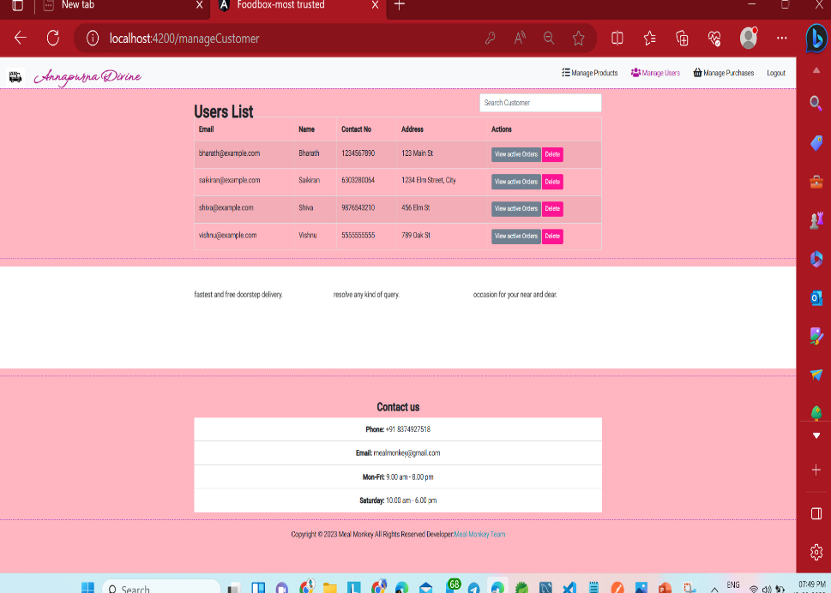
Admin Managing the user transactions
Admin can add a product
Admin managing the users

Slide 16
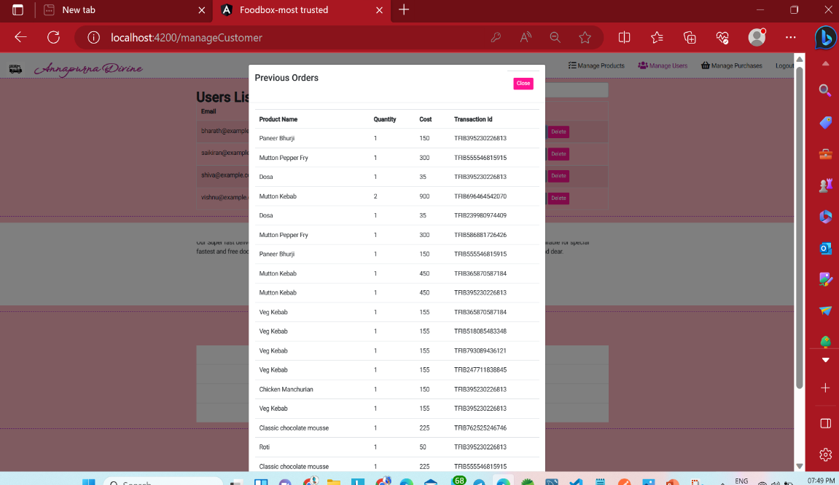
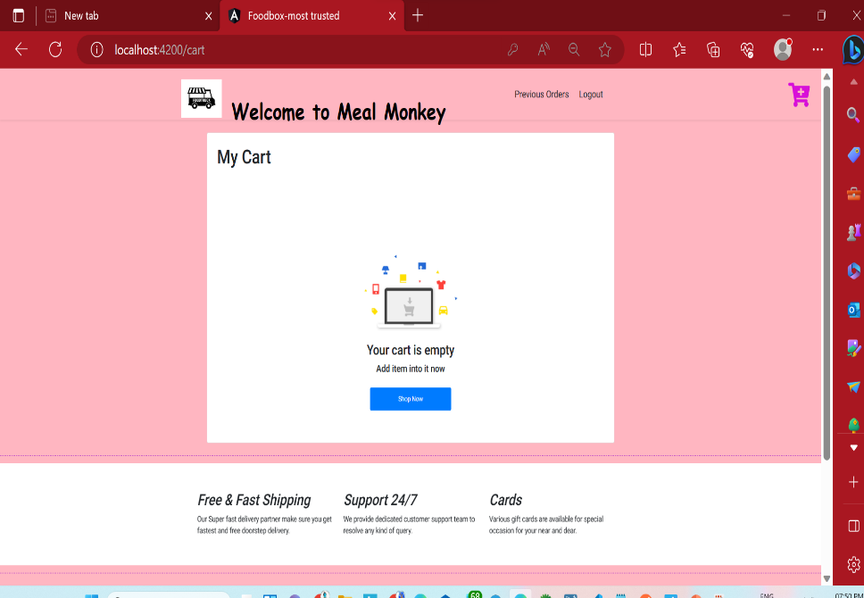
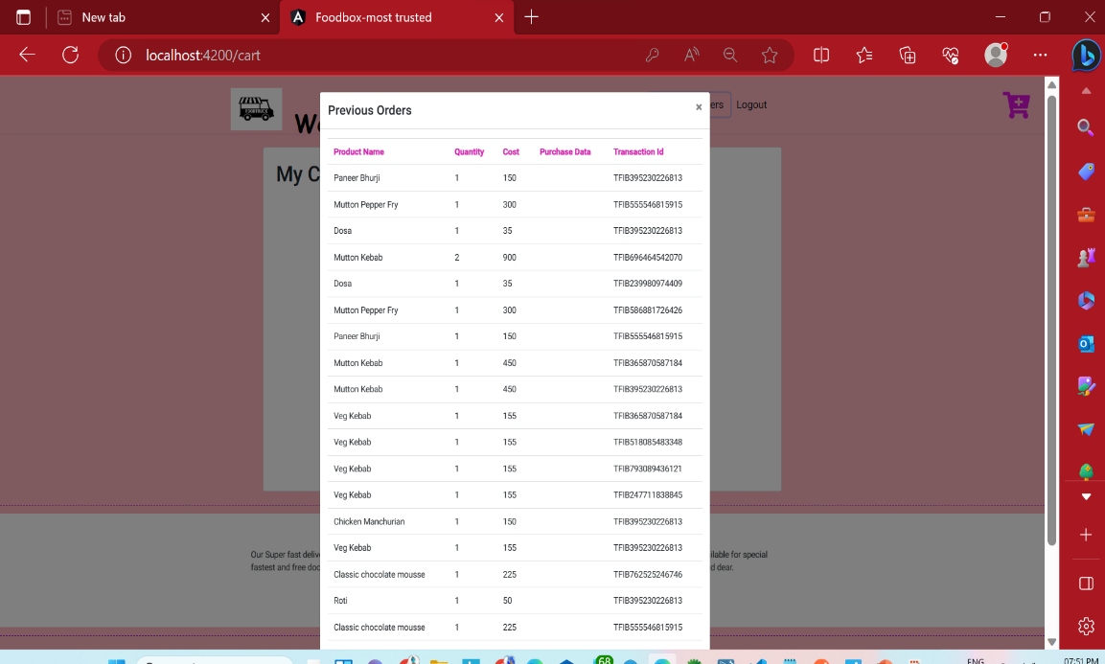
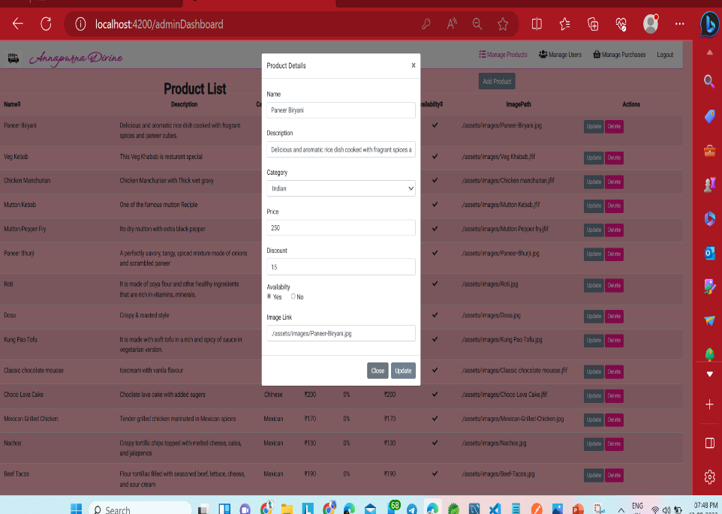
Admin Managing the each user transactions
Empty cart of the customer
User can see his previous orders
Admin can update the details

Slide 17
CONCLUSION
An online food ordering system is developed where the customers can make an order for the food and avoid the hassles of waiting for the order to be taken by the waiter.
Using the application, the end users register online, read the E-menu card, and select the food from the E-menu card to order food online. Once the customer selects the required food item the chef will be able to see the results on the screen and start processing the food.
To provide a bug-free Online Food Delivery system to Users as well as Admin. The main objective is here to provide a nice and secure platform for Ordering Food.To maintain the records of Products, Categories available into the system.

Slide 18
THANK YOU
Team:Meal Monkey

